Slide 1

MRCM
SPORT MEET SYSTEM
BY
MRCM ICT CLUB
Highlight the use of technology to enhance communication, engagement, and efficiency.

Slide 2
Agenda
Introduction
Our team
Plan for product launch
System information
Main roles
Owner roles
Main sequence
Prototype of website​
Areas of focus

Slide 3

“Optimize the world and change the system with our powerful systems”
-Quotes

Slide 4
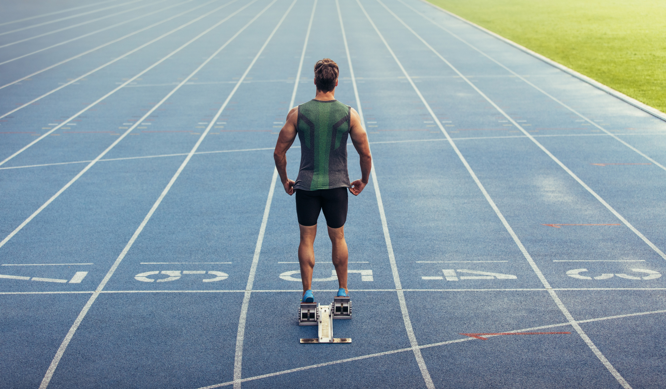
Hello and Welcome
Introduction
Hello, We are the members of the ICT club and we are excited to introduce you to our project for Mahinda Rajapaksha College Matara's school sports meet control system.
The purpose of this project is to create a system that will efficiently manage and organize the school's sports meet. This is crucial to ensure that the event runs smoothly and that all participants have a positive experience.
Organizing and managing a sports meet can be a daunting task, especially when dealing with a large number of participants and events. By creating a control system, we can streamline the process and ensure that everything runs smoothly from start to finish.

Slide 5

Our Team
Vimukthi Indunil
Achira Nimnaka
Dineth Idusara
K. Prabhasha
Hirun Kovida

Slide 6




PLAN FOR PRODUCT LAUNCH
PLANNING
PREVIEW
DESIGN
PROGRAMMING
LAUNCH
Finding the requirements and creating algorithm for this.
Make a presentation about our project and discuss about it.
Design a UI and UX for this.
Start coding the backend and frontend.
Deploy strategic networks with powerful system.

Slide 7




System Information
Landing page
Staff Dashboard
Admin Dashboard
User friendly UI with all pages.
YouTube live and live updatable broadcast messages.
Houses and live updatable scores with data.
Events with live data.
Staff members can submit scores to the admin section.
They can edit non-sensitive data about event.
Admins can add staff members.
Edit/Add events.
Send custom broadcast messages.
Approve scores from the staff.

Slide 8





MAIN ROLES
Owners
Staff Members
Event Manager
Clients
Owners
Event Manager
Staff Members
Clients
They have all responsibilities
of this sport meet system
They can inspect house activities and they can report results after events.
They can add students for sports and they also can report result after events but result want to be approved by event managers
They can only view the website and view score

Slide 9




OWNER ROLES
Owners who have all responsibilities of this website
1
2
3
Manage other roles
Check submitted scores
Start Events
They can manage another staff accounts for usual (data compromisation)
They can check scores after staff member or event manager submitted the event score
4
5
Approve scores
Update website
They can approve submitted scores according to principal’s permission
Keep website alive from updating live score

Slide 10






MAIN SEQUENCE
Mark participants
Step 1
Start Event
The staff members can add students for each event through the staff account we given
After marking participants
start event and live stream
of event
Step 2
Step 3
Submit result
Send results to principal
after ending of the event the event managers have to submit event results to owners
The result what was given by the event manager send to the principal for approvement
Step 4
Step 5
Approve result
Update website
Step 6
After the principal’s permission approve the result for next step
Update website with event summery ,scores and house points

Slide 11
B2B MARKET SCENARIOS
Develop winning strategies to keep ahead of the competition
Capitalize on low-hanging fruit to identify a ballpark value
Visualize customer directed convergence
AREAS
OF
FOCUS
CLOUD-BASED OPPORTUNITIES
Iterative approaches to corporate strategy
Establish a management framework from the inside

Slide 12


Thank
You!
Thank you for the official presentation of Sport Meet system of MRCM
“Prepare for the new era”

